Slide 1
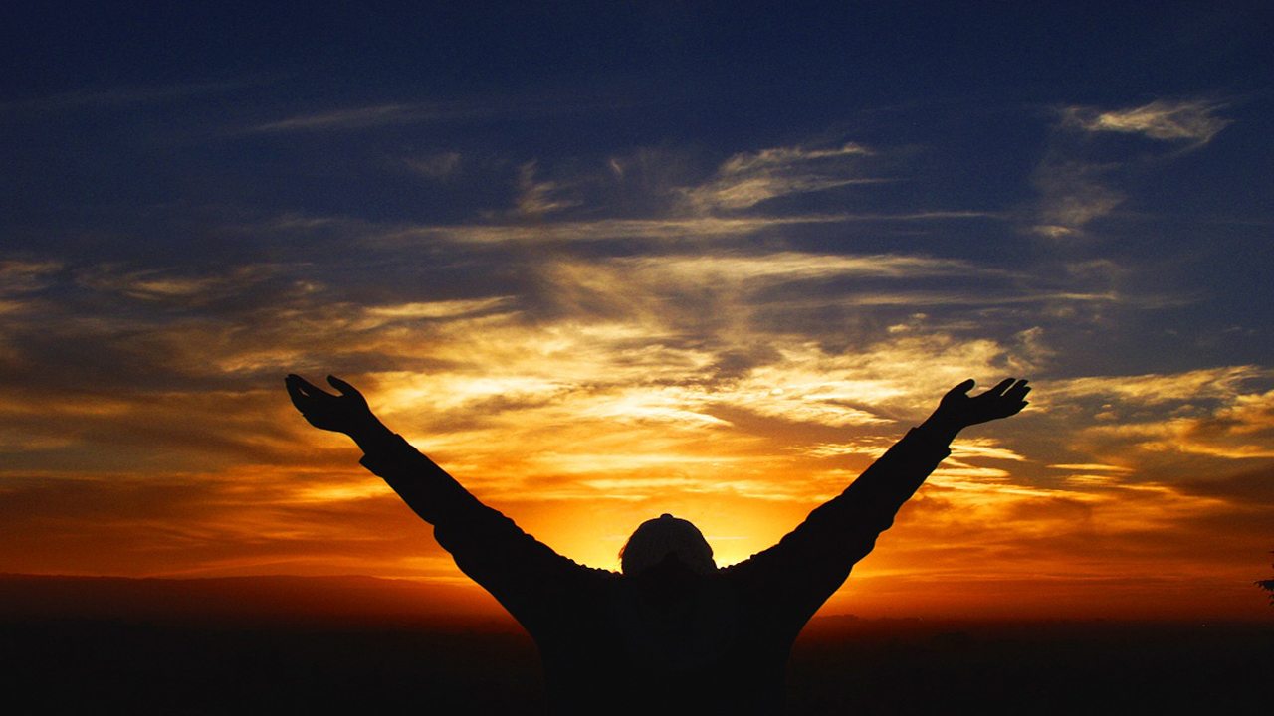
Praise and Worship: The Specifics
Psalm 138

Slide 2

Psalms always comes back to this one truth:
God is to be praised.

Slide 3
I. A Specific _______
Attitude
His whole heart.
Psalm 138:1
“You shall love the Lord your God with all your heart, with all your soul, and with all your mind.”
Matthew 22:37

Slide 4
“I will praise”- Praise is an act of my will, not of my emotions.
We don’t live our lives by our emotions, we walk by _____
faith!
My specific attitude is to _________ with my ___________, trusting that my _______ will fall in line with my ____.
praise Him
whole heart
feelings
faith

Slide 5
II. A Specific _______
Method
Some Old Testament words translated as “praise”:
Halal: To be clamorously
foolish
Barak: To kneel
Shabach: to shout
Tehillah: praise in song
Todah: give thanks
Zamar: To strike the strings
Yadah: Extended hands

Slide 6
Praise is not a position of the body, praise comes from the heart.
The act of extending the hands to God is found in Scriptures like:
Psalm 28:2, 63:4, 119:48, 134:2, 141:2 143:6, I Timothy 2:8.

Slide 7
Lifting of the hands is seen as:
A sign of surrender
A child reaching to his/her father
A spontaneous act of celebration and joy in victory.

Slide 8
III. A Specific _____
Result
“Though I walk in the midst of trouble, You will revive me; You will stretch out Your hand against the wrath of my enemies, and Your right hand will save me.”
Psalm 138:7

Slide 9
Praise brings deliverance.
“...David strengthened himself in the Lord his God.”
1 Samuel 30:6
David practiced “self-talk”

Slide 10
“For He has delivered me out of all trouble...”
Psalm 54:7
“In God I have put my trust; I will not be afraid. What can man do to me?”
Psalm 56:11
“I will cry out to God Most High, to God who performs all things for me. He shall send from heaven and save me...God shall send forth His mercy and His truth.”
Psalm 57:2-3

Slide 11
Praise is the opposite of complaining.
Praise is the opposite of whining.
Praise is the antidote for depression.
Praise is the antidote for despair.
“To give them beauty for ashes, the oil of joy for mourning, the garment of praise for the spirit of heaviness.”
Isaiah 61:3

Slide 13
Praise and Worship: The Specifics
Psalm 138

